Slide 1
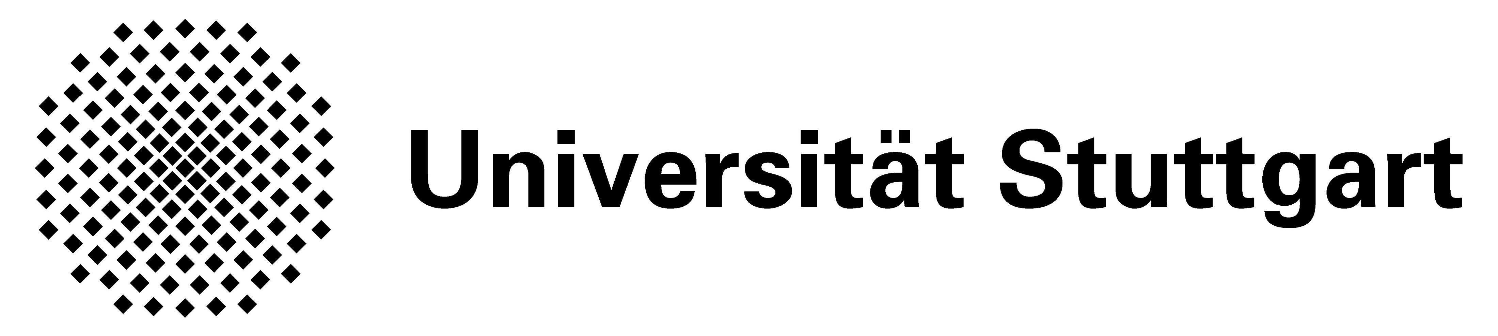
FINAL PRESENTATION
A data driven efficient multiscale simulation Tool using hybrid ai modelling framework for short fiber reinforced thermoplastics
Pavan bhat keelanje srinivas^{1,2}, Argha protim DEY¹, FABIAN WELSCHINGER¹, andre mielke², Prof. tim ricken²
1 Robert Bosch GmbH, Corporate Sector Research and Advance Engineering
2 Institute of statics and dynamics of aerospace structures(ISD), universitÄt stuttgart
24.06.2022
Notes:
Hello Everyone, my name is Pavan. My master thesis topic is

Slide 2
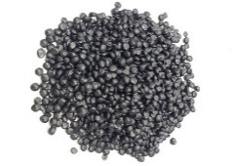
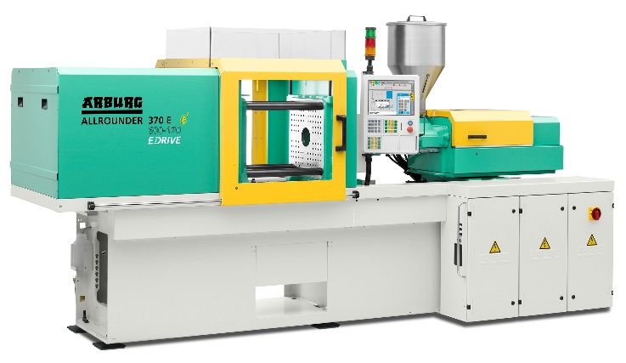
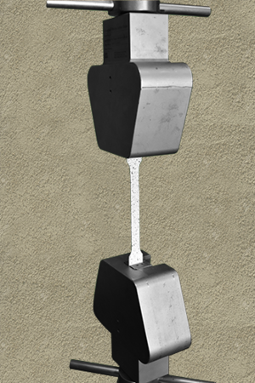
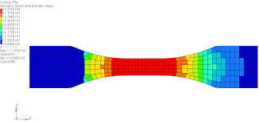
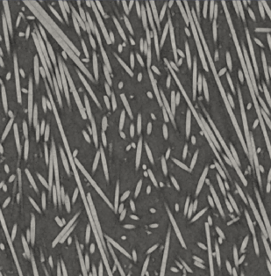
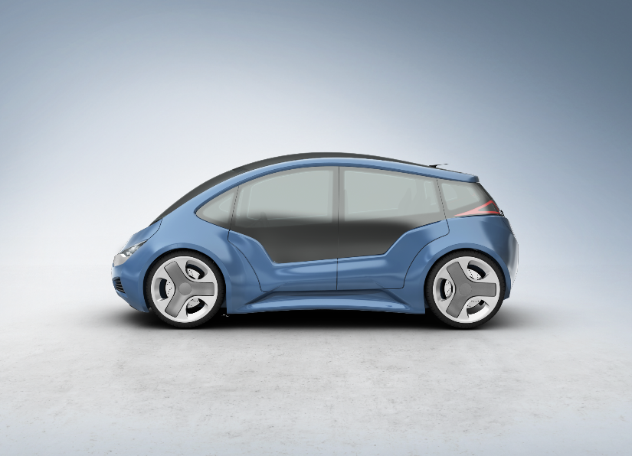

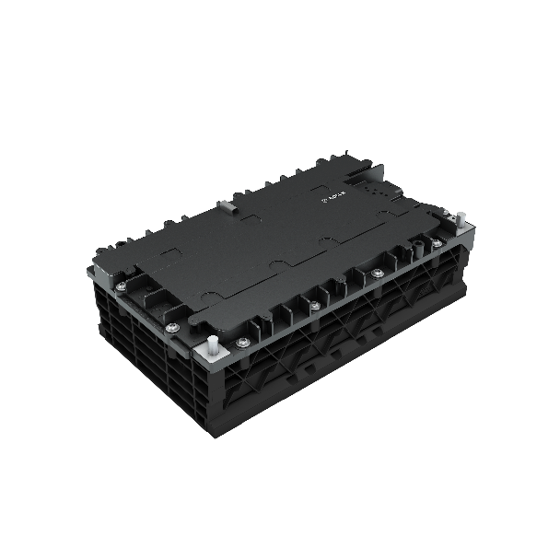
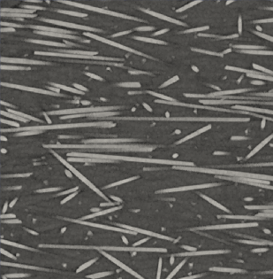
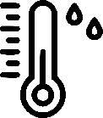
Reliability despite complexity
Motivation
From real to virtual testing
Real test specimen
Multiscale simulation model
Complex processing
Virtual data with only few experiments
Complex geometry
Complex loading
F
F
F
Real
experimental data
Virtual experimental data
t
t
t
F(t)
Creep
Quasi-static
Notes:
Material class in focus : SFRPs
Injection molding, complex microstructure and undergo Harsh loading conditions
Necessary to evaluate the reliability of such a material.
One need to perform experiments to evaluate material reliability, which can be resource expensive. So the aim is to perform some experiments and replace few others with somthing like the multiscle simulations.

Slide 3
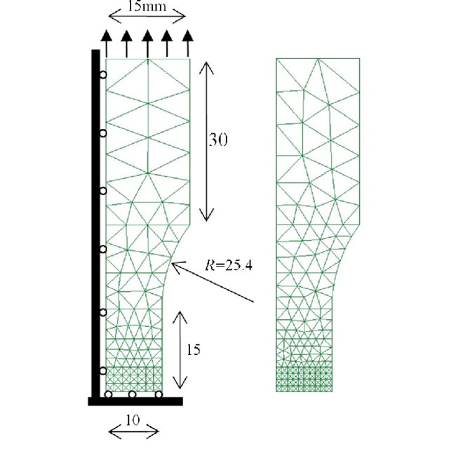
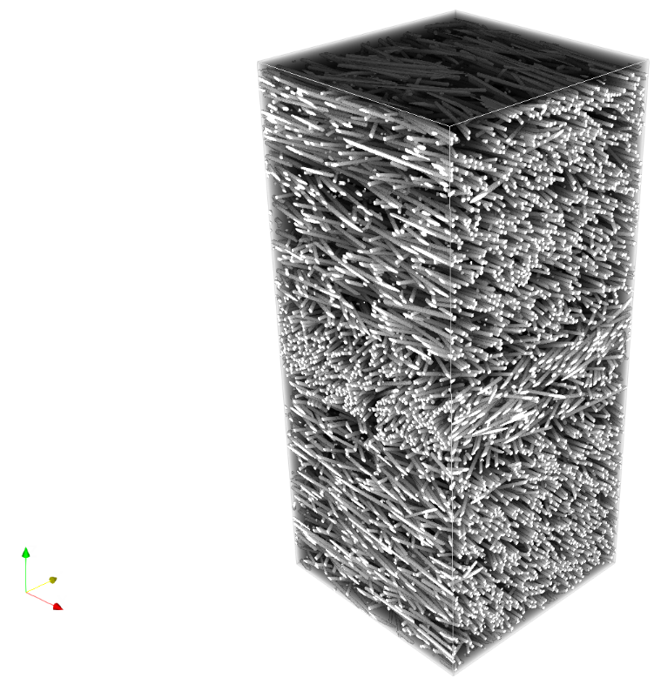
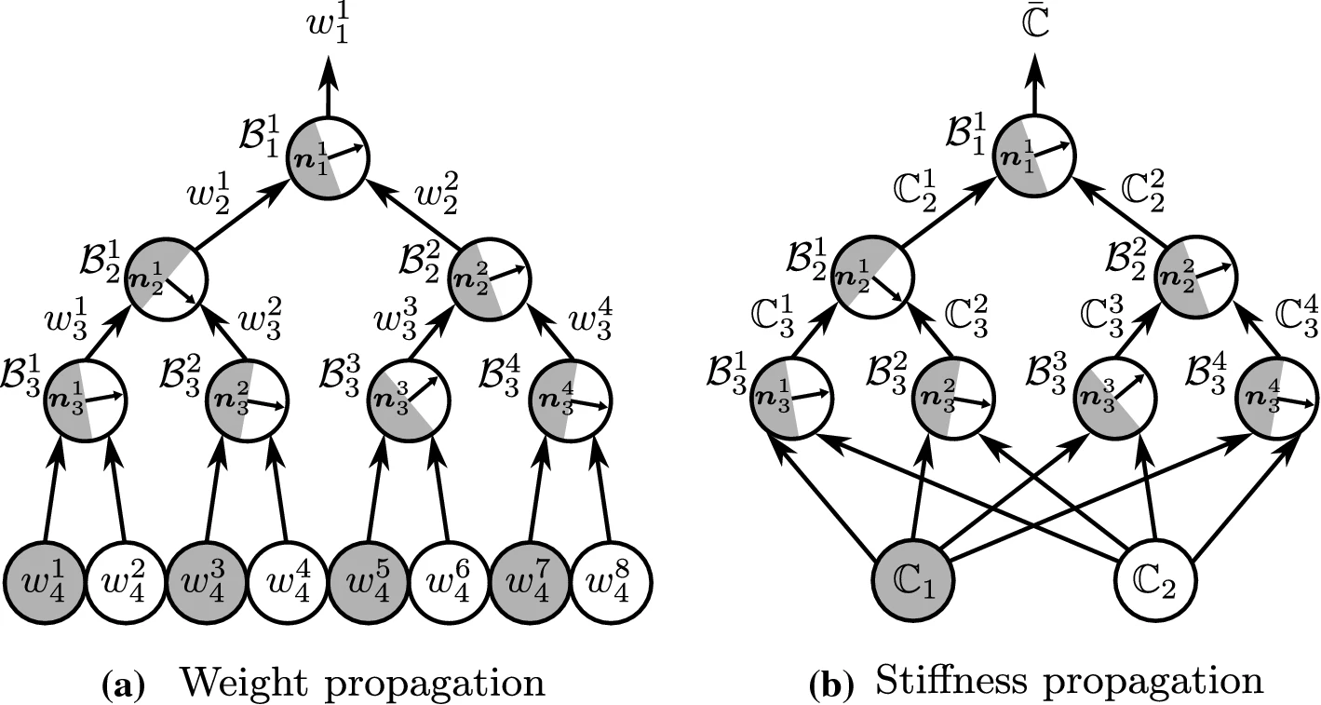
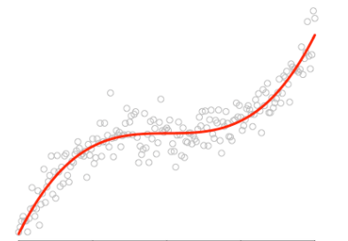
How to build a Multiscale simulation model?
Two scale approach
Methods to perform homogenization
Hybrid modelling approach
Deep material network-DMN
PDE cell problem
Analytical methods
Not accurate
Direct DMN
Numerical methods
Too slow FE/FE-FFT
DMN
DMN with interpolation
Material homogenization
NN/Model order reduction
bad extrapolation/ Slow convergence
OFFLINE TRAINING
ONLINE EVALUATION
Hybrid Modelling
Promising approach confidence of Physics
CT image/
Molding
simulation
FE-full field
simulations
ML used to find hidden relationship
Physics based prediction-extrapolation
Notes:
Building a multiscale simulation model requires transfer of information from microscale to macroscopic full field simulations. One can obtain this from Ct image of material or erforming a injection molding simulation which give the local distribution of fibers in the material.
Once this is known one performs material homogenization to ascertain the material behaviour at that point.
Homogenization is done by solving the PDE of the cell problem. The literature states a few methods with some draw backs . This work propses a Hybrid Modelling approach to estimate the solution to the cell problem.
The specific approach is Deep Material Networks or DMN. DMN are two types the direct DMN and DMN with interpolation which is the focus of this work.
Direct DMN has two parts. The offline training and online evaluation. In offline training ML is used to find hidden relation in the data in the linear elastic domain . In the online phase this relation ship is used to perform physics based extrapolation in the nonlinear elastic domain.

Slide 4
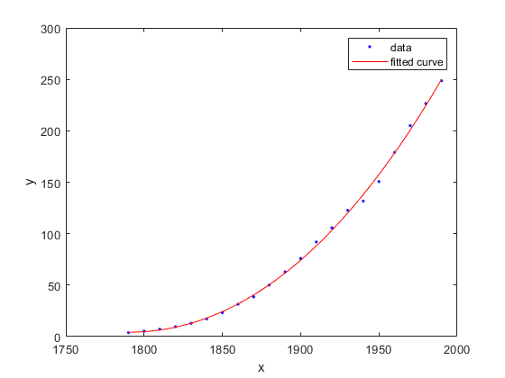
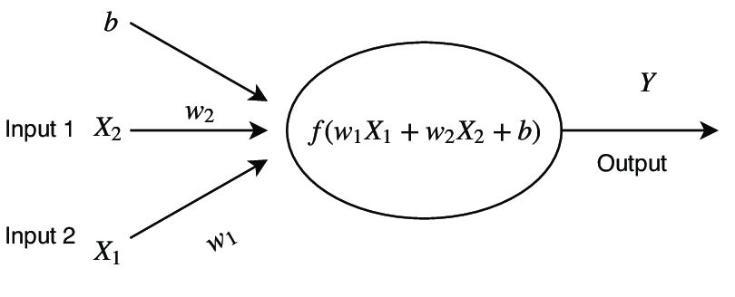
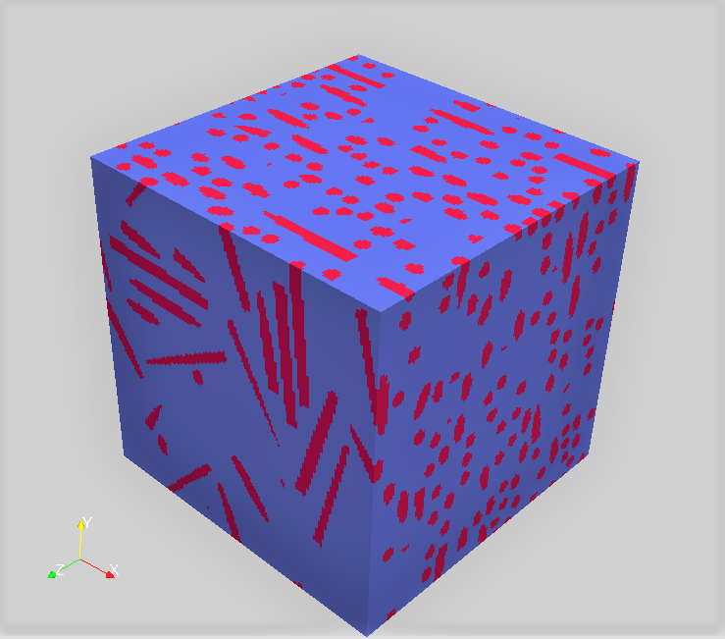
An intuitive understanding
Direct DMN
Offline phase-Direct DMN
OFFLINE TRAINING
Complex function
Off the shelf model
Data
from curve
Tune weights to fit complex curve
Complex Microstructure
Off the shelf analytical model
Data
from Linear FFT
Tune quantity and arrangement of laminate to fit complex microstructure
Notes:
One can get an intuitive understanding of offline phase with a regression problem. Consider a complex function. One can take data from this function and fit an off the shelf function. Here the weights can be tuned to reprodce the complex function.
On a similar note consider a complex microstructure. The mechanical response of the micrsotructure can used by ML to find an equivalent laminate microstructure. Here one tunes the amount of material in the each of the laminates and arrangement of these laminates to reproduce the response.

Slide 5
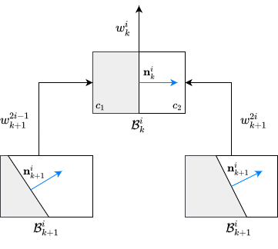
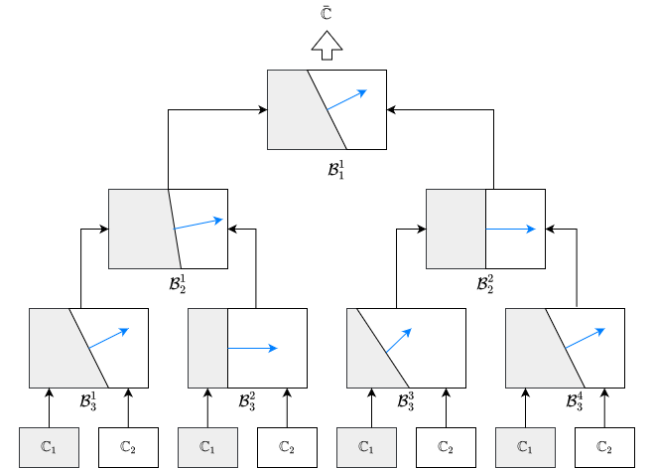
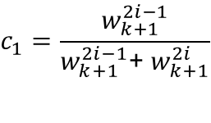
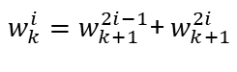
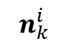
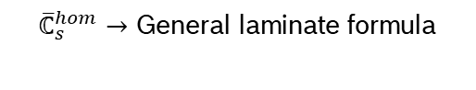
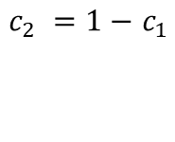
Direct DMN
Deep Material Network
OFFLINE TRAINING
Structure of DMN-Building block
Milton equation
$${\overline{ℂ}}_{s}^{DMN}$$
Output
Layer 1
Layer 2
Building block of DMN
$w_{k}^{i}=w_{k+1}^{2i−1}$+${ w}_{k+1}^{2i}$
$$n_{k}^{i}$$
Layer 3
$$c_{1}=\frac{w_{k+1}^{2i−1}}{w_{k+1 }^{2i−1}\text{+}{ w}_{k+1}^{2i}}$$
Input
$c_{2} =1−$ $c_{1}$
${\overline{ℂ}}_{s}^{hom}→$ General laminate formula
Notes:
Looking at the DMN itself. It is a binary tree neural network. The input the lowest layer are the stiffness matrices of the two phases. The activation function is the Milton equation with the Relu activation in each neuron. So as we go up the ladder a more complex material is created and the effective stiffness is compared with ground truth to get an error. This error is back propagated to identify the weights and normal. The weights parameterize the volume fraction and normal give a mathematical description of the laminate arrangement.

Slide 6
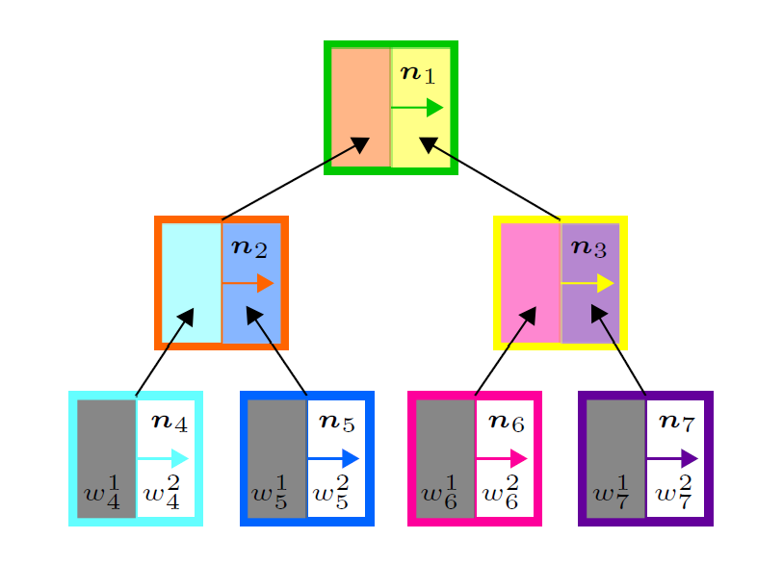
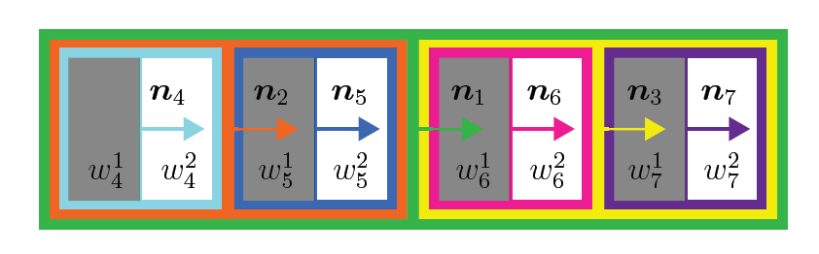
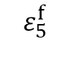
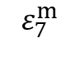
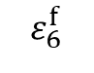
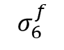
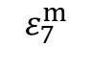
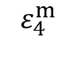
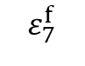
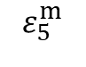
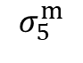
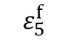
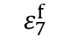
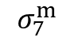
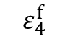
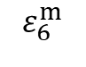
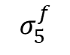
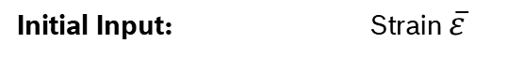
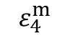
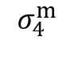
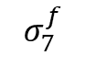
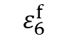
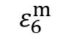
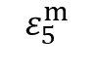
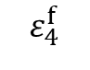
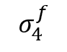


Structure of a DMN – Online phase
Deep Material Network
Hierarchical representation^{[5,13]}
Flattened representation^{[5,13]}
Initial Input: Strain $\overline{ε}$
$$ε_{4}^{f}$$
$$ε_{4}^{m}$$
$$ε_{5}^{f}$$
$$ε_{5}^{m}$$
$$ε_{6}^{f}$$
$$ε_{6}^{m}$$
$$ε_{7}^{f}$$
$$ε_{7}^{m}$$
Input:
$$σ_{4}^{f}$$
$$σ_{4}^{m}$$
$$σ_{5}^{f}$$
$$σ_{5}^{m}$$
$$σ_{6}^{f}$$
$$σ_{6}^{m}$$
$$σ_{7}^{f}$$
$$σ_{7}^{m}$$
Output:
Using the respective material laws for fiber and matrix
$$\overline{σ}=\sum_{i}{\left(c_{i}^{f}σ_{i}^{f}+c_{i}^{m}σ_{i}^{m}\right)}$$
$$ε_{4}^{f}$$
$$ε_{4}^{m}$$
$$ε_{5}^{f}$$
$$ε_{5}^{m}$$
$$ε_{6}^{f}$$
$$ε_{6}^{m}$$
$$ε_{7}^{f}$$
$$ε_{7}^{m}$$
Final Output:
Calculate:
Fiber f : modelled as linear elastic
Matrix m : modelled using a non-linear plasticity-creep coupled law
Notes:
Note that every node at the input level of the DMN has its own vector of internal variables

Slide 7



Introduction of fully coupled plasticity and creep model
Modelling of Matrix
Material in focus: PBT GF30
Matrix:
Fully coupled plasticity and creep law
von Mises plasticity^{[6]} with exponential linear hardening
Norton type power law creep with exponential strain hardening^{[7]}
Fibers: Linear elastic ($E=72000 MPa,v=0.22$)
Additive strain decomposition of the matrix $ε$
$$ε=ε^{ⅇ}+ε^{p}+ε^{c}$$
$ε^{ⅇ}$ elastic strain
$ε^{p}$ von Mises elastoplastic strain
$ε^{c}$ creep strain
Notes:
Material 2 phases
Matrix with fully coupled model

Slide 8

















Structure of a DMN – Offline phase
Direct-Deep Material Network
$ℂ^{hom,3}$, $w_{1}^{2}$
DMN parameters and identification:
Weights $w$
Direction of laminate $n$
Identified via the cost function^{[13]}
minimized using optimizer like ADAM^{[15]}
Four parameters per building block
$$c_{1}^{1}$$
$$c_{1}^{2}$$
$$n_{3}$$
$$w_{3}^{1}$$
$$w_{3}^{2}$$
6
$$n_{6}$$
7
$$n_{7}$$
$$ℂ^{1}$$
$$ℂ^{2}$$
Fig. 4: Building block of DMN
$$J_{p}\left(C_{act}^{hom},C_{pred}^{hom}\right)=\frac{1}{N_{s}}{\left\|\frac{\left\|C_{act,s}^{hom}−C_{pred,s}^{hom}\right\|p_{iocal}}{\left\|C_{act,s}^{hom}\right\|p_{local}}\right\|}_{p_{global}}{+λ\sum_{j=1}^{2}{\left(\sum_{\dot{i}=1}^{\frac{2^{k−1}}{2}}{w_{i,BL}^{j}}−c_{hom}^{j}\right)}}^{2}$$
$w_{1}^{2}=w_{3 }^{1}$+${ w}_{3}^{2}$
$$c_{1}^{1}=\frac{w_{3 }^{1}}{w_{3 }^{1}\text{+}{ w}_{3}^{2}}$$
$$c_{1}^{2}=\frac{{ w}_{3}^{2}}{w_{3 }^{1}\text{+}{ w}_{3}^{2}}$$
$p_{local}$ = 1, $p_{global}$ = 1
$ℂ^{hom}$= f ($ℂ^{1}$, $ℂ^{2}$ ,${ n}_{6}$ ,${ n}_{7}$,${ n}_{3}$,${ c}_{1}^{1}$, $c_{1}^{2}$) ^{[14]}
Notes:
conserve volume fraction by regularization

Slide 9
Activation function- Milton equation with ReLU
Direct DMN
Direct-Deep Material Network
OFFLINE TRAINING
Signify a mathemetical arrangement
$${\left(ℙ\left(n_{k}^{i}\right)+α{\left[ℂ_{k}^{i}−α𝕀_{s}\right]}^{−1}\right)}^{−1}=c_{1}{\left(ℙ\left(n_{k}^{i}\right)+α{\left[ℂ_{k+1}^{2i−1}−α𝕀_{s}\right]}^{−1}\right)}^{−1}+c_{2}{\left(ℙ\left(n_{k}^{i}\right)+α{\left[ℂ_{k+1}^{2i}−α𝕀_{s}\right]}^{−1}\right)}^{−1}$$
signifies material in laminate
Notes:
Cost function holds the mean error of the stiffness and the regularization of the weights to converse the volume fraction.

Slide 10



Cost function
Direct DMN
Direct-Deep Material Network
OFFLINE TRAINING
$$J_{p}\left(C_{act}^{hom},C_{pred}^{hom}\right)=\frac{1}{N_{s}}{\left\|\frac{\left\|C_{act,s}^{hom}−C_{pred,s}^{hom}\right\|p_{iocal}}{\left\|C_{act,s}^{hom}\right\|p_{local}}\right\|}_{p_{global}}{+λ\sum_{j=1}^{2}{\left(\sum_{\dot{i}=1}^{\frac{2^{k−1}}{2}}{w_{i,BL}^{j}}−c_{hom}^{j}\right)}}^{2}$$
$p_{local}$ = 1, $p_{global}$ = 1
DMN parameters and identification:
Weights $w$
Direction of laminate $n$
Identified via the cost function
minimized using optimizer like ADAM
Notes:
Cost function holds the mean error of the stiffness and the regularization of the weights to converse the volume fraction.

Slide 11






Workflow of a Direct-DMN
Direct DMN
Direct-Deep Material Network
$$A$$
$$ℂ_{s}^{p1}$$
$$ℂ_{s}^{p2}$$
_{Find vector (n)}
$$s$$
$$\left\{ℂ_{s}^{p1} ,ℂ_{s}^{p2} ;{\overline{ℂ}}_{s}^{RVE} \right\}$$
OFFLINE
FFT solver
Sampled stiffness for each phase
Input
Output
_{Find weights (w)}
Microstructure
Training data
Equivalent laminate microstructure
Nonlinear
material model
Variational problem on the laminates
Nonlinear solution method
Mechanical response
ONLINE
Equivalent laminate microstructure
Boundary
conditions
Notes:
So looking at the overall workflow
In the offline phase, One to generate a microstructure and assign the stiffnesses to the phases. Perform linear elastic homogenization to get the training and validation data. This is passed into the training to find the weights and normals which define a equivalent laminate microstructure.
In the online phase a variational problem is setup over the laminates solved using a nonlinear solution method with the respective nonlinear material models and boundary conditions to obtain a mechanical response.
This mechanical response has to be equivalent to the complex microstructure. So effectiveness of the training is not just how it fits the training data, but also on how it performs in the online phase.

Slide 12


Need to modify dependency of n
Direct DMN
Direct-Deep Material Network
Single Microstructure
Weights K_{th} layer∏$w_{k}^{i}$
Volume fraction
Goal:
For fixed volume fraction
Parameterize the n to allow DMN to interpolate
Fibre orientation
direction of laminates $n$
Notes:
In the multiscale context, when you look at the CT scans each point has a different microstructure arrangement. Identify a ML model for every case is impractical. So the need to allow the DMN to interpolate. So the direction of laminates are parameters with fiber orientation.

Slide 13






Fiber orientation Tensor Triangle parameterization in DMN
DMN with interpolation
Deep Material Network with interpolation
OFFLINE TRAINING
FOT triangle
λ₁ λ₂
_{Transform to shape parameters} $φ$
$$\left[\begin{matrix}1 & 1/3 & 1/2 \\ 0 & 1/3 & 1/2 \\ 1 & 1 & 1\end{matrix}\right]\left[\begin{matrix}φ_{1} \\ φ_{2} \\ φ_{3}\end{matrix}\right]=\left[\begin{matrix}λ_{1} \\ λ_{2} \\ 1\end{matrix}\right]$$
Using linear interpolation to angles
$α$= $p_{1}φ_{1}+p_{2}φ_{2}+p_{3}φ_{3}$
$β$= $q_{1}φ_{1}+q_{2}φ_{2}+q_{3}φ_{3}$
_{Direction of lamination (n)}
$$n=\left[\begin{matrix}sin\left(α\right)cos\left(β\right) \\ sin\left(α\right)sin\left(β\right) \\ cos\left(α\right)\end{matrix}\right]$$
Notes:
This where the FOT traingle comes in. The direction of laminate in this case is considered with a cylindrical coordinate system with angles alpha and beta and thses angles are parameterized with the eigen values lamda1 and lamda 2 of the FOT with linear interpolation along with the interpolation parameters p and q.

Slide 14




Fiber orientation Tensor Triangle
DMN with interpolation
Deep Material Network with interpolation
OFFLINE TRAINING
A need to automate the process
FOT triangle
λ₁ λ₂
_{Transform to shape parameters} $φ$
Parameters learnt
Learn 7 parameters per neuron
Weights w
[$p_{1}$, $p_{2 , }p_{3}$] parameters to interpolate $α$
[$q_{1}$, $q_{2 , }q_{3}$] parameters to interpolate$β$
Using linear interpolation to angles
_{Direction of lamination (n)}
Recreate any microstructure of same volume fraction
_{Find parameters(p,q)}
$$\left\{ℂ_{s}^{p1} ,ℂ_{s}^{p2},\text{λ}\text{1 }\text{λ}\text{2 };{\overline{ℂ}}_{s}^{RVE} \right\}$$
FFT^{[2]} solver
Input
Output
Training data
_{Find weights}
_{(w)}
Notes:
When we look at the workflow, say we sample three points on the FOT triangle, corresponding to theree points three micrsotructures are generated and post linear elastic homogenization , the input dat also consists of eigen values.
This is fed into the machine learning model to find the weights and interpolation parameters . So a bunch of laminates are jointly identified and the same laminates are re arranged to reproduce the mechanical response of any given microstructure on the Fot trainagle.
One could identify a need for an automation framework to perform this task.

Slide 15



discretization
NumPro-Deep: Automation framework and discretization
Need parallelization of procedure to utilize HPC
Need parallelization of procedure to utilize HPC
Microstructure folder structure
Microstructure generator
Material sampling
Linear FFT run and storage
Input data processing &checks
Training folder structure
Microstructure folder structure
Ground truth generation
Post processing
Effectiveness of training
Online evaluation
Training and tracking jobs on HPC
Notes:
When we sample 4 points on the FOT trainagle. Each of the point has a set of repetitive steps. There is a lot of data generated which has to be managed and most of all one has to use the parallelization of the HPC.
That is why the work propses and framework called NumPro-Deep to automate and aid Model identification process.. When we look at the FOT triangle we see an analogy to Finite element, the sampling frequency has analogy of discretization.
So this work chose a FE software architecture.

Slide 16

Object Oriented programming and FE like tracking of objects
NumPro-Deep: Automation framework and discretization
Central
Configuration file
Node class Nonlinear
Element
class-Nonlinear
Element class
Node class
Node object
1_D4 to a_109_D109
D109 class
D4 class
Node object
1_D4 to a_4_D4
D10 class
Node object
5_D10 to a_10_D10
D31 class
Node object
11_D31 to a_31_D31
Notes:
A central configutation file, holds all the parameter inputs by a user.
An object of the element class is created based on the discretization chosen. When we chose D31 discretization, 31 different node objects are automatically sampled from the input space and associated with D31 object.
Here the element class tracks the training, hyperparameter, online validation workflows . Associated data is automatically documented and manged by it.
The node class exclusively manages microstructure parameter sets and running data generation for each of the nodes and maintains the folder structures.
The online validation is done on 109 diffrent nodes and all of the ground truth generation and simulation sare manges by a seprate nonlinear node and element class.

Slide 17
Object Oriented programming and FE like tracking of objects
Automation framework and discretization
Central control through a single config file
Allows automatic creation of folder structure.
Automatic tracking of existing Data.
Uniquely identifies data generated at every stage with an identification number.
Automatically documents the settings used during training ,data generation and post-processing/distillation phase.
Parallelization of multiple trainings through HPC
Parallelization of FFT and abaqus runs using local folder structure for ground truth generation.
*226 documented trainings run but many were ineffective of merit
Parameters | Values
Time per training | ~1-1.5 days
Number of trainings run –D10,D31 | ~100* fully completed
Process of interest | Workflow with Sequential run | Workflow based on Framework
Training | >3 months | <1 month
Ground Truth generation | 54.5 hours | 18.16 hours
More than 3 times speedup in both cases
Notes:
There is a central configuration file from which the user gives inputs to the system and there is no intervention until the online validation phase.
The system automatically detects and manages the data with unique ID.
!!!Most of all, the objects are used to paralleize jobs on the HPC and this has significantly reduced the timelines.

Slide 18
Object Oriented programming and FE like tracking of objects
Automation framework and discretization
Parameters | Values
Time per training | ~1-1.5 days
Number of trainings run –D10,D31 | ~100* fully completed
Process of interest | Workflow with Sequential run | Workflow based on Framework
Training | >3 months | <1 month
Ground Truth generation | 54.5 hours | 18.16 hours
More than 3 times speedup in both cases
Notes:
There is a central configuration file from which the user gives inputs to the system and there is no intervention until the online validation phase.
The system automatically detects and manages the data with unique ID.
!!!Most of all, the objects are used to paralleize jobs on the HPC and this has significantly reduced the timelines.

Slide 19


Training of DMN - Microstructure and Error metric
Numerical Investigations
The DMNs are trained by the data generated using the sampling method proposed in Liu et al.^{[4]}
The DMNs are evaluated against FFT^{[2]} simulations performed using FeelMath^{[16]}
Error measures
Max and mean Error measures
Parameters | Values
Number of voxels | 128³
Fiber diameter | 10 µm
Fiber length | 100 µm
Length of unit cell | 256 µm
Minimum distance between fibers | 4 µm
Volume fraction | 17.8%
$$e_{ij,t}^{plast}=\frac{\left.∥{\overline{σ}}_{ij,t}^{DMN}−{\overline{σ}}_{ij,t}^{FFT}∥\right.}{\left.∥{\overline{σ}}_{ij,max}^{FFT}∥\right.}$$
$$e_{max}^{\text{plast} }=\max_{i∈(1,3),j∈(i,3)} \max_{t∈𝒯} \left(e_{ij,t}^{\text{plast} }\right)$$
$$e_{mean}^{\text{plast} }=\max_{i∈(1,3),j∈(i,3)} {mean}_{t∈𝒯} \left(e_{ij,t}^{\text{plast} }\right)$$
$$e_{ii,i∈(1,3),t}^{\text{creep} }=\frac{∥{\overset{‾}{ε}}_{ii,t}^{DMN}−{\overset{‾}{ε}}_{ii,t}^{FFT}∥}{∥{\overset{‾}{ε}}_{ii,max}^{FFT}∥}$$
$$e_{ii,i∈(1,3),max}^{\text{creep} }=\max_{t∈𝒯} \left(e_{ii,t}^{\text{creep} }\right)$$
Notes:
For plasticity case study the framework was proved with the microstructure parameter set shown. It also shows the error metric used to evaluate the models.
Note that for creep case study the framework was not used.

Slide 20

Training of DMN – sampling size and Hyperparameters
Numerical Investigations using DMN
Parameters | D31
Number nodes | 31
Number of training samples per node | 45
Number of validation samples per node | 5
Total number of training data | 1395
Total number of validation data | 155
Hyper-parameters | D31
Number of layers | 9
Optimizer | ADAM
Optimizer parameters | $β$₁ =0.99 $β$₂ =0.99 amsgrad
Learning rate modulation | Exponential decay and cosine annealing with warm restart
Learning rate | 0.0005
Learning rate modulation parameters | T_0=20 , T_multi=1 lr_min=0.00005 , γ = 0.999
Number of epochs | 6000
Batch size | 45
Penalty parameter | 1000
Good results achieved during the elasticity-based training results in good results in plasticity.
D4 and D10 fail to give good results and also was very time expensive to validate
Notes:
The table shows the most important hyper parameters for the best DMN.
In general good results in elastic based training gives good results in plasticity.

Slide 21

Workflow and the challenges in online evaluation
Numerical Investigations using DMN
discretization
Time expensive
Data Processing,micro-simulation-data transformation,tracking
Pytorch module with ID and state tracking
Online evaluation
Hyper-parameter tuning
Notes:
One of the bottle neck of the workflow was to define the correlation between the offline and online phase.
This makes judging the hyper parameter tuning very difficult.
That is why intermediate states every 50 epochs were stored and evaluated.
Also due to high number of validation points the validation was time expensive.

Slide 22


Online plasticity evaluation and distillation
Numerical Investigations using DMN
Parameters | Plasticity without distillation
Time for one online evaluation using DMN | 60-90 sec
Number of epochs | 6000
States storage frequency | Every 50 epochs
Number of states to be evaluated | 120
Number of nodes on which evaluation is done | 109
Evaluations for orthotropic boundary conditions | 6 load cases
Total number of evaluations to validate a DMN training | 120x109x6=78480 evaluations
Total time taken for full training evaluation | 9-14 days

Slide 23
Online plasticity evaluation and distillation
Numerical Investigations using DMN
Parameters | Plasticity without distillation
Time for one online evaluation using DMN | 60-90 sec
Number of epochs | 6000
States storage frequency | Every 50 epochs
Number of states to be evaluated | 120
Number of nodes on which evaluation is done | 109
Evaluations for orthotropic boundary conditions | 6 load cases
Total number of evaluations to validate a DMN training | 120x109x6=78480 evaluations
Total time taken for full training evaluation | 9-14 days
Need to reduce evaluations

Slide 24



Distillation Algorithm
Numerical Investigations using DMN
1_D4
2_D4
3_D4
a_4_D4
Notes:
Here I have plotted the online error of 4 nodes as shown

Slide 25

Distillation Algorithm
Numerical Investigations using DMN
1_D4
2_D4
No correlation with online evaluation
Every node is unique
3_D4
a_4_D4
Notes:
One cannot see a lot of correlation with the offline training

Slide 26
Distillation Algorithm
Numerical Investigations using DMN
1_D4
2_D4
Best DMN at 2500
3_D4
a_4_D4
Notes:
The best DMN for 1_D4 is at 2500 th epoch and

Slide 27
Distillation Algorithm
Numerical Investigations using DMN
1_D4
2_D4
Best DMN at 2500
3_D4
Best DMN at 7500
a_4_D4
Notes:
For a_4_D4 it is 7500 epoch

Slide 28
Distillation Algorithm
Numerical Investigations using DMN
1_D4
2_D4
S
E
T
T
A
stack the nodes as filter papers for distillation
3_D4
a_4_D4
Error metric
Notes:
This where the distillation algorithm was built. Here the nodes are like filter papers with an error metric which work like dynamically changing pore size . All the states are passed in through this stack.

Slide 29
Distillation Algorithm
Numerical Investigations using DMN
1_D4
2_D4
S
E
T
T
Choose a low error metric
A
3_D4
a_4_D4
Error metric
Notes:
First a error metric is chosen

Slide 30
Distillation Algorithm
Numerical Investigations using DMN
1_D4
2_D4
S
E
T
T
Evaluate models that pass the previous node
A
3_D4
a_4_D4
Error metric
Notes:
Onlx models that pass the error metric are evelauated in the next stage.

Slide 31
Distillation Algorithm
Numerical Investigations using DMN
1_D4
2_D4
S
E
T
T
A
3_D4
a_4_D4
Error metric
None of the models pass the metric
Notes:
Here we see more filtration in 3_D4. But all the models now have error nore than error metric.

Slide 32
Distillation Algorithm
Numerical Investigations using DMN
1_D4
2_D4
S
E
T
T
A
3_D4
a_4_D4
Next node evaluation doesnt happen and the data is tracked
Error metric
Notes:
So in next stage all models are eleminated

Slide 33
Distillation Algorithm
Numerical Investigations using DMN
1_D4
2_D4
Increment the metric
Only new models are evaluated,since old data is tracked
S
E
T
T
A
3_D4
a_4_D4
Error metric
Notes:
So in the next stage we go back to the first node and increment the error metric.

Slide 34
Distillation Algorithm
Numerical Investigations using DMN
1_D4
2_D4
S
E
T
T
A
Repeat until, good model is obtained
3_D4
a_4_D4
Error metric
Notes:
We repeat this until a good model comes out. The first model that passes through all the 109 nodes is the best model.

Slide 35
Distillation Algorithm
Numerical Investigations using DMN
1_D4
2_D4
S
E
Node ranking also helps
T
T
A
3_D4
a_4_D4
Error metric
Notes:
Further one can see that a_4_D4 has more errors than 3_D4. So if the grey node was ranked above the blue one, then more models have been elemeinated early on.

Slide 36
Online evaluation and distillation
Numerical Investigations using DMN
Parameters | Plasticity-without distillation | Plasticity with distillation
Time for one online evaluation using DMN | 60-90 sec | 60-90 sec
Number of epochs | 6000 | 6000
States storage frequency | Every 50 epochs | Every 50 epochs
Number of states to be evaluated | 120 | 120
Number of nodes on which evaluation is done | 109 | 109
Evaluations for orthotropic boundary conditions | 6 load cases | 6 load cases
Total number of evaluations to validate a DMN training | 120x109x6=78480 evaluations | 800x6=4800 evaluations
Total time taken for full training evaluation | 9-14 days | ~15 hours
Notes:
This way the number of experiments were reduced to 4800 evaluations and around 15 hours.

Slide 37



Error distribution plot-plasticity and FFT vs DMN speedup
Numerical Investigations using DMN
Parameters | Values
Discretization | D31
Training ID | A_0031
Epoch state that passed the distillation | 2650
Smallest Loss | 0.01108
Mean validation error | 0.01523
max $e_{ii}^{p}$ | 10.91 %
mean $e_{ii}^{p}$ | 7.31 %
Variance of the distribution | 3.1287
max $e_{ii}^{p}$
Notes:
Here we show the best model showing an error distribution over the FOT triangle. It has a very high variance in error.

Slide 38



Error distribution plot-plasticity and FFT vs DMN speedup
Numerical Investigations using DMN
Parameters | Values
Discretization | D31
Training ID | A_0031
Epoch state that passed the distillation | 2650
Smallest Loss | 0.01108
Mean validation error | 0.01523
max $e_{ii}^{p}$ | 10.91 %
mean $e_{ii}^{p}$ | 7.31 %
Variance of the distribution | 3.1287
mean $e_{ii}^{p}$
Notes:
Mean error is around 7.31 percent

Slide 39


Error distribution plot-plasticity and FFT vs DMN speedup
Numerical Investigations using DMN
Parameters | Values
Discretization | D31
Training ID | A_0031
Epoch state that passed the distillation | 2650
Smallest Loss | 0.01108
Mean validation error | 0.01523
max $e_{ii}^{p}$ | 10.91 %
Process of interest | FFT | DMN | Speed up factor for multiscale simulations
Prediction time | 30 minutes to 4 hours | <1 minute | >30
Notes:
Here is the training curve.
All in all, the for plasticity , it cakes less than a minutes for homogenization and we shall have atleast 30 to 400 times speed up.

Slide 40



Creep-Choosing load level and time
Numerical Investigations using DMN
We choose the Epoch state 2650 of A_0031 for the creep evaluation for convenience.
As a postprocessing step, we evaluate the elastoplastic and the creep errors at this parameter state for three long term tensile tests as shown.
Notes:
Since for plasticity, errors in prediction was within engineering factor of safety, it was decided to continue creep case study.
Since doing hyper parameter tuning again took more time, it was decided to benchmark creep validation procedure only for D4 discretization.
For this, the best DMN for plasticity A_0031/2650
The boundary conditions were a 3 long term tensile test for creep case study.

Slide 41
Creep testing Load levels and time
Numerical Investigations using DMN
Parameter | Load case | 1_D4 | 2_D4 | 3_D4 | a_4_D4
Load Levels in MPa | T11 | 80 | 60 | 50 | 60
 | T22 | 50 | 60 | 50 | 50
 | T33 | 50 | 50 | 50 | 50
Number of time steps | All | 32 | 32 | 32 | 32
Time of load application in seconds | All | 1.48 x 10⁵ | 1.48 x 10⁵ | 1.48 x 10⁵ | 1.48 x 10⁵
Notes:
In order to initiate creep response in the material, every microstructure configuration requires one to select suitable load levels and duration of loading.
Theses were the values selected.

Slide 42



Creep testing results 1_D4
Numerical Investigations using DMN
Parameter | Load case | 1_D4
Error metric in % | T11 | 11.41
 | T22 | 23.95
 | T33 | 23.54

Slide 43



Creep testing results 2_D4
Numerical Investigations using DMN
Parameter | Load case | 2_D4
Error metric in % | T11 | 6.86
 | T22 | 36.53
 | T33 | 15.75

Slide 44



Creep testing results 3_D4
Numerical Investigations using DMN
Parameter | Load case | 3_D4
Error metric in % | T11 | 16.62
 | T22 | 10.25
 | T33 | 6.43

Slide 45



Creep testing results a_4_D4
Numerical Investigations using DMN
Parameter | Load case | a_4_D4
Error metric in % | T11 | 36.04
 | T22 | 76.14
 | T33 | 25.16
Notes:
One can see that the error are high modstly do to high nonlinearity and it requires different model identification process during hyper parameter tuning.

Slide 46
Summary and outlook
Conclusion
Summary
Outlook
Extension to DMN for interpolation was achieved.
Data-science platform called NumPro-Deep was created to ease the model identification process.
NumPro-Deep was proved for a material case study and an interpolated DMN was identified within 10.91% accuracy for plasticity case study.
Creep validation procedure for DMN was benchmarked for D4 discretization.Due to high nonlinearity, errors were seen to be high.
The identified model can be used to build virtual material characterization worflow for inverse parameter identification.
To prove NumPro-Deep for Creep case study, an efficient implementation of online phase is required.
Full automation of NumPro-Deep can be achieved by using evaluation procedure for informed hyper parameter tuning.

Slide 47
Thank You

